Slide 1
Competition II: Springleaf
Sha Li (Team leader)
Xiaoyan Chong, Minglu Ma, Yue Wang
CAMCOS Fall 2015
San Jose State University

Slide 2
Agenda
Kaggle Competition: Springleaf dataset introduction
Data Preprocessing
Classification Methodologies & Results
Logistic Regression
Random Forest
XGBoost
Stacking
Summary & Conclusion
Notes:
Our project is also a Kaggle competition sponsored by Springleaf.
First, we will give a brief introduction to our project and dataset.
Next, we will show how we preprocess our data.
After that, we will talk about some classification methods and results. The methods we will emphasis are logistic regression, random forest, Xgboost, and stacking.
Finally, we will summarize.

Slide 3

Kaggle Competition: Springleaf
Objective: Predict whether customers will respond to a direct mail loan offer
Customers: 145,231
Independent variables: 1932
“Anonymous” features
Dependent variable:
target = 0: DID NOT RESPOND
target = 1: RESPONDED
Training sets: 96,820 obs.
Testing sets: 48,411 obs.
Notes:
Springleaf is a financial company who provides loan service.
Direct mail offers provide high value to customers and are a fundamental part of Springleaf’s marketing strategy. In order to target their efforts, they want focus on customers who would likely to respond to a direct offer.
Our goal is to find a best model that can predict whether customers will respond to a direct mail offer.
Their dataset comes with 145,231 row of observations, and 1932 anonymous data features.
When we say data is “anonymous”, we mean first any personal identifiable information has been stripped out, but furthermore, each vars are unlabeled. This could cause misinterpretation of data.
The dataset has 2 labeled variables: ID and target. The response variable “target” with either a 0 or 1 value. Target 0 means not to a direct offer, 1 means to respond to a direct offer.
We have divided the dataset into training and testing sets to construct our models. 2/3 of the data are used as training set and the left 1/3 as testing set.

Slide 4
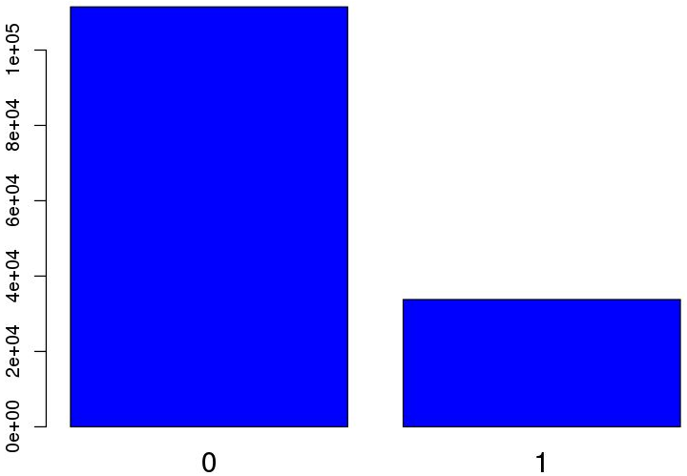
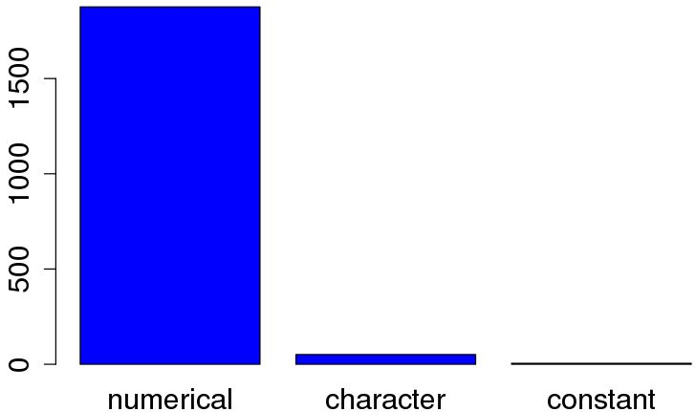
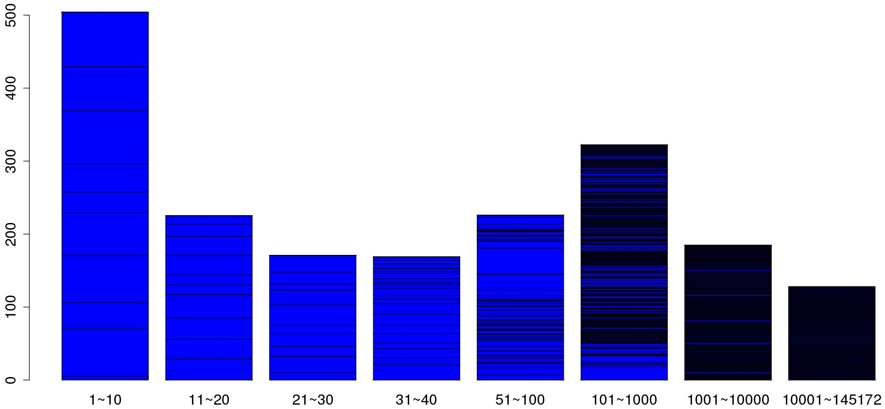
Dataset facts
76.7%
R package used to read file: data.table::fread
Target=0 obs.: 111,458
Target=1 obs.: 33,773
Numerical variables: 1,876
Character variables: 51
Constant variables: 5
Variable level counts:
67.0% columns have
levels <= 100
23.3%
Class 0 and 1 count
Variables count
Count of levels for each column
Notes:
Most of our work are done in R, some methods are implemented in Python due to performance issues.
To read the data file, we used a R package called data.table, which is the most efficient file reading tool in R for large data files.
After looking at the data, we have noticed that there are about a 4:1 ratio between the target 0 an 1 class. The uneven distribution of target could result in low accuracy in some methods.
There are 1876 numerical vars, 51 character vars, and 5 constant var in the dataset.
The figure shows the count of levels for each column. There are about 67% columns have levels 100 or less, which indicates that even some vars are showing as numerical value, they are probably still categorical data.

Slide 5
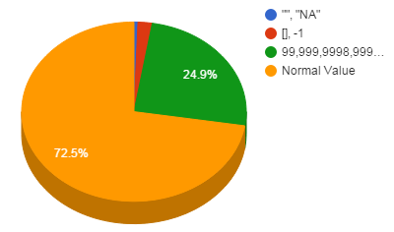
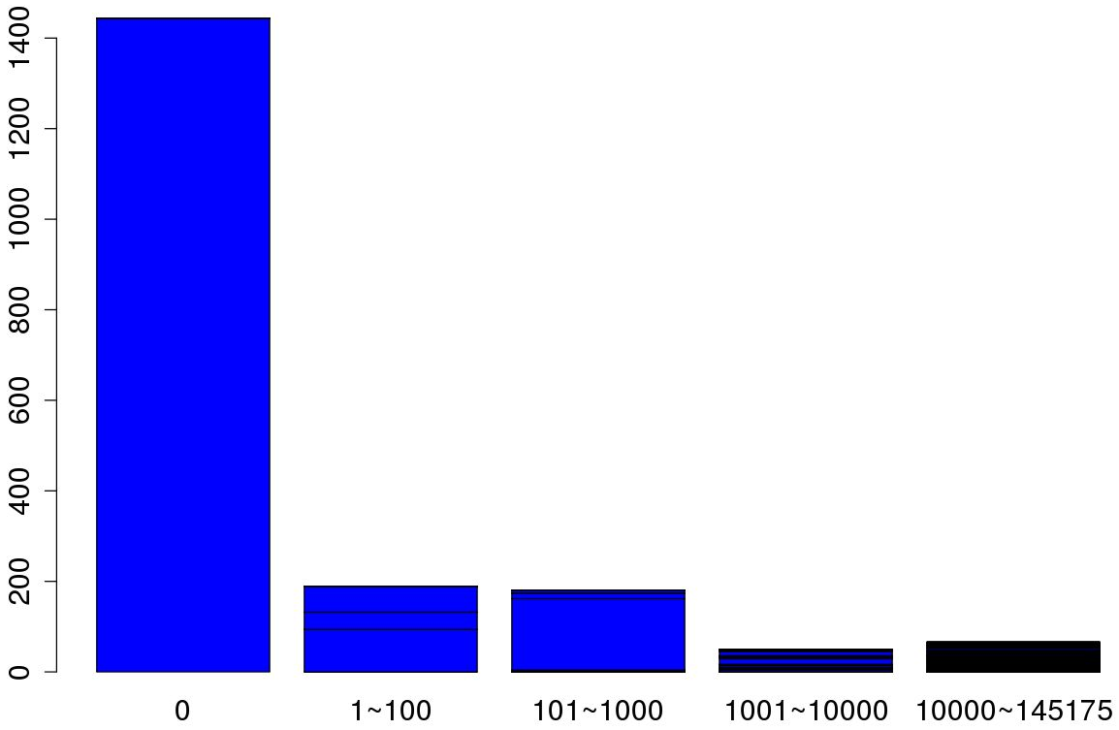
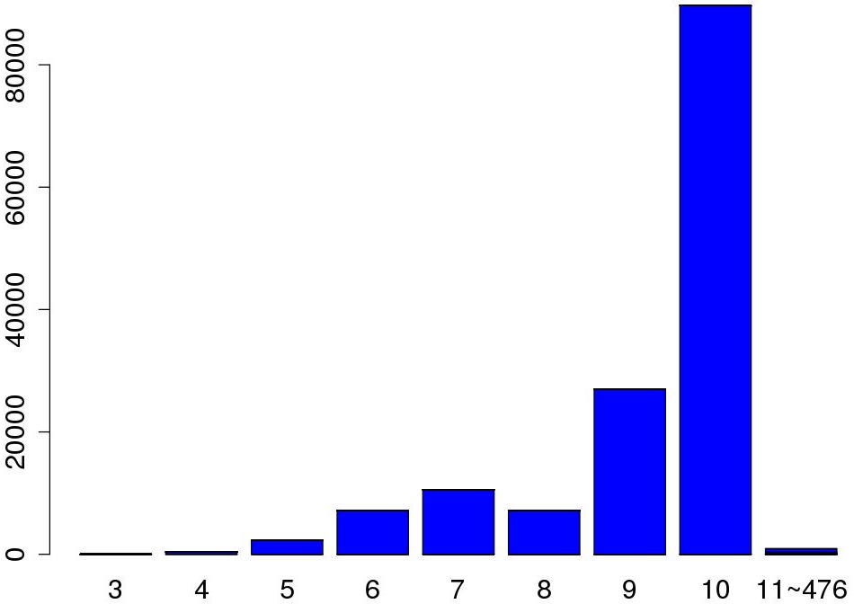
Missing values
“”, “NA”: 0.6%
“[]”, -1: 2.0%
-99999, 96, …, 999, …, 99999999: 24.9%
25.3% columns have missing values
61.7%
Count of NAs in each column
Count of NAs in each row
Notes:
There are 3 kinds of missing values in our datasets. “”, “NA” are the default missing values for all input methods. “[]” and -1 are the missing values appeared in the character vars, the other numbers, such as, -99999, 99, 97, 98,etc. are appeared in numerical vars to represent different kind of missing values.
There are total of 27% missing values in our data set.
This figure shows the count of missing values for each column, about 25.3% columns have missing values.
The figure on the right shows the missing value counts on each row. We can see every row has 3 or more missing values, more than 60% of rows have 10 or more missing values.

Slide 6
Challenges for classification
Huge Dataset (145,231 X 1932)
“Anonymous” features
Uneven distribution of response variable
27.6% of missing values
Deal with both numerical and categorical variables
Undetermined portion of Categorical variables
Data pre-processing complexity
Notes:
As real world data, it has all the real-world data problems.
First, dataset is huge.
For this particular project, the data features are also “anonymous”, as I mentioned early, it means the data are unidentified, which add difficulties to determine the data types.
Our 2 target classes has a 4:1 ratio in our dataset, it means the lower class are under-sampled, which could cause low accuracy for prediction.
Since data are normally prepared by different people, collected from different offices, typically there are inconsistency of data representation. In our situation, missing values are exactly like this. There are about 30 ways to represent missing value in our data set.
There are both numerical and categorical variables in our data set. Since some numerical variable has very low level counts, we think there are a large portion of categorical variables.
Due to the all these reasons, there are a lot of complexity added to data preprocessing. And data preprocessing will be crucial to our project.

Slide 7
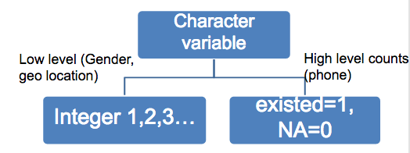
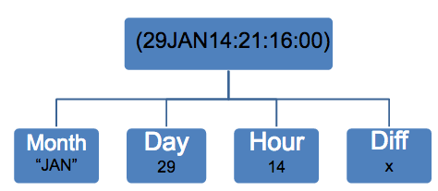
Data preprocessing
Remove ID and target
Replace [] and -1 as NA
Remove duplicate cols
Replace character cols
Replace NA by median
Regard NA as a new group
Replace NA randomly
Remove low variance cols
Normalize
Log(1+|x|)

Slide 8
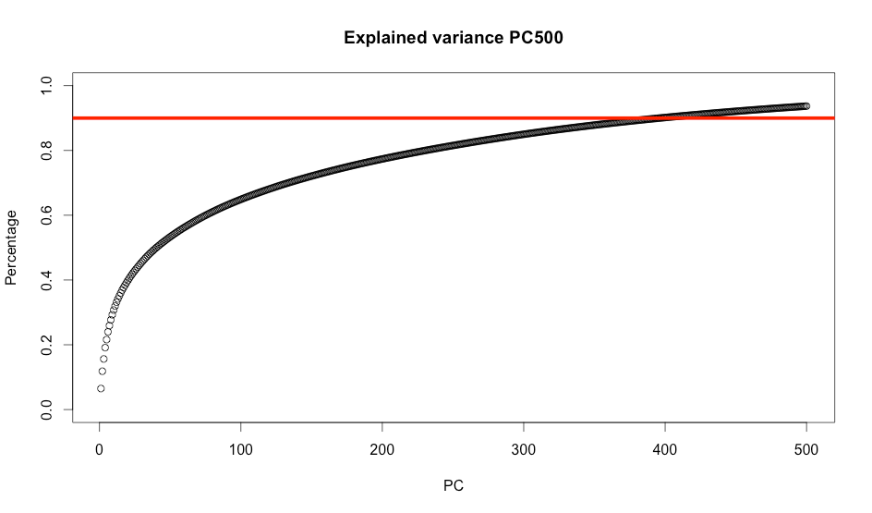
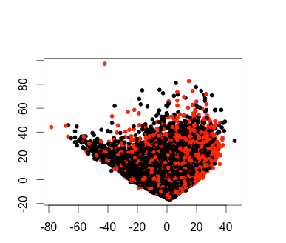
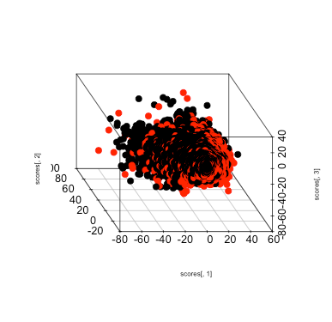
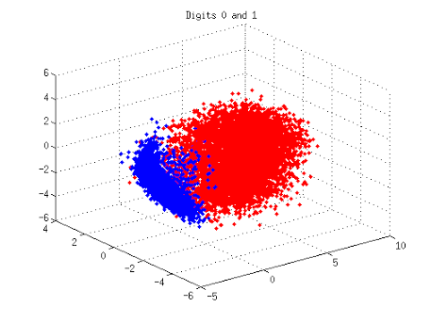
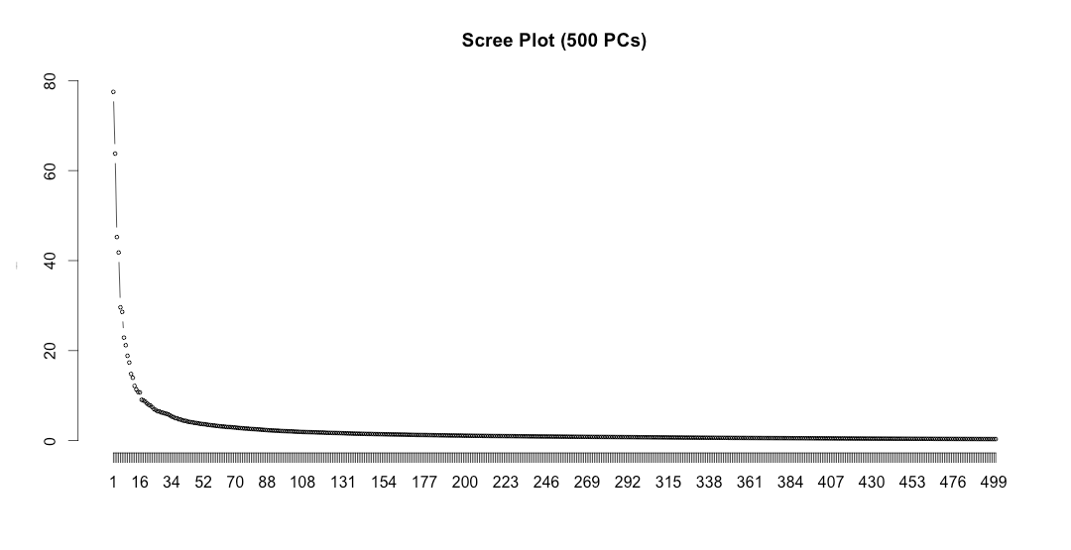
Principal Component Analysis
When PC is close to 400,
it can explain 90% variance.
pc1
Notes:
(1)Since we still have around 1000 variables after data cleaning, we consider to do dimensional reduction on our dataset. The first method we use here is PCA. (2)The top figure shows the relation between number of pcs and the percentage that corresponding pc can explain. According to the figure, we can see if we try to explain 90% variance, we need around 400 pcs, which is a big reduction on the dimension. (3) In order to visualize our dataset, we made 2-dimensional and 3- dimensional scatter plot. We can see neither of them can distinguish the two categories. This makes sense to us since our data is so complex, there is no way to use just a few pcs to express the whole dataset.

Slide 9
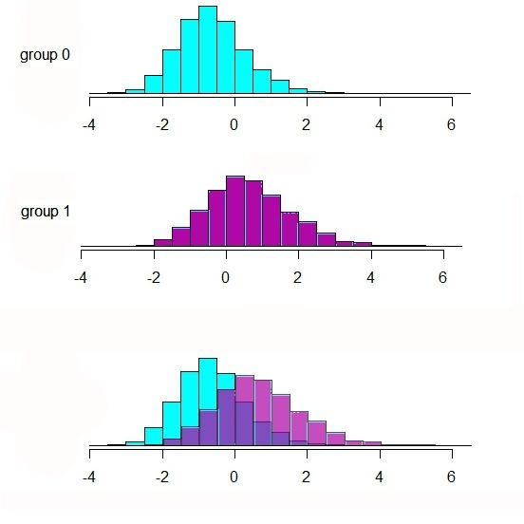
LDA: Linear discriminant analysis
We are interested in the most discriminatory direction, not the maximum variance.
Find the direction that best separates the two classes.
Significant overlap
µ1 and µ2 are close
µ1
µ2
Var1 and Var2 are large
Notes:
It a good method to find a subset of variables which keep the variance as many as possible. It tries to minimize the reconstruction error, taking our points from the original space to a low dim space. pca try to minimize the difference between them. It doesn’t take the classification into account.
Now we apply Linear discriminant analysis LDA to see how well we can distingulish the two group in one dimensional space. The key idea of LDA is finding a low dimensional space, a linear dimsensional space, if we project the original data pionts on it, we can have the two classes be separated as good as possible. the definiation of good is : the projected means of the two class on the linear space are far from each other at the same time the projected spread or we can say the variance of each group are as small as possible.
Let’s see the results after applying pca, the blue one is distribution of group 0 projected in one dimension space and the purple is group1 projected in one dim space, both of them approximately follow normal distribution in one dim. Unfortunately, the means difference of the two groups is still very small while the variance of each group is large which lead to the projected points of two group overlap seriously on this one dim space.
It shows our data is more complicated than we can expected. We need to find other technique to handle it.

Slide 10
Methodology
K Nearest Neighbor (KNN)
Support Vector Machine (SVM)
Logistic Regression
Random Forest
XGBoost (eXtreme Gradient Boosting)
Stacking
Notes:
We tried bunch of machine learning methods to achieve the goal.
In this section, I will talk about these method, and focus on .

Slide 11
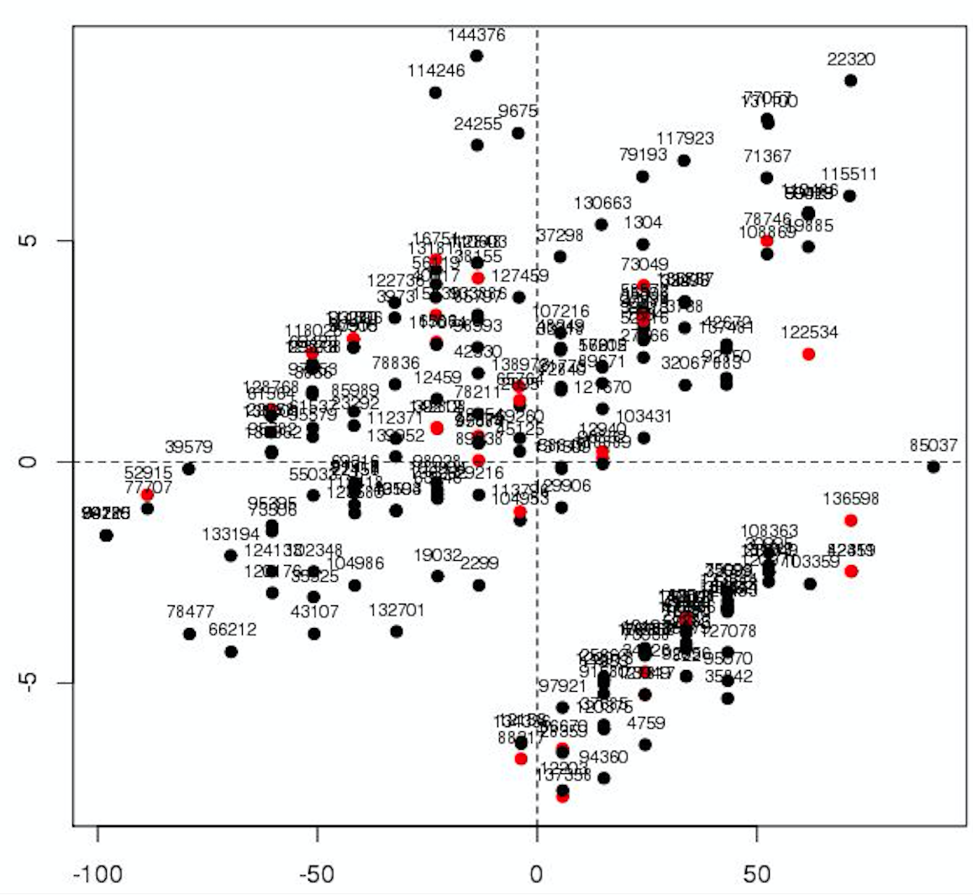
K Nearest Neighbor (KNN)
Overall Accuracy
Accuracy
Target = 1 Accuracy
Target =0
Target =1
Notes:
The higher the k, the less target = 1 can be identified

Slide 12
Support Vector Machine (SVM)
Expensive; takes long time for each run
Good results for numerical data
Confusion matrix |  | Prediction
Truth |  | 0 | 1
 | 0 | 19609 | 483
 | 1 | 5247 | 803
 | Accuracy
Overall | 78.1%
Target = 1 | 13.3%
Target = 0 | 97.6%
Notes:
Expensive
Target = 1 too low
Our data a lot of categorical

Slide 13
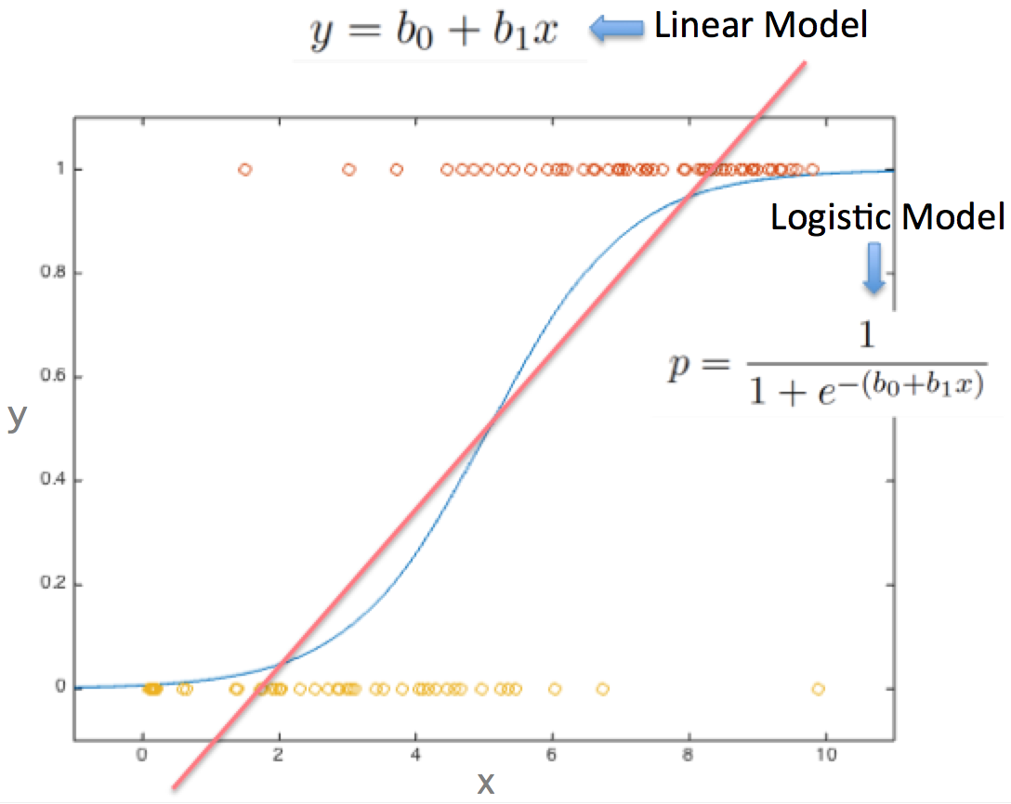
Logistic Regression
Logistic regression is a regression model where the dependent variable is categorical.
Measures the relationship between dependent variable and independent variables by estimating probabilities
Notes:
Logistic regression measures the relationship between the categorical dependent variable and one or more independent variables by estimating probabilities using a logistic function
Logistic regression can be seen as a special case of generalized linear model and thus analogous to linear regression. The model of logistic regression, however, is based on quite different assumptions (about the relationship between dependent and independent variables) from those of linear regression. In particular the key differences of these two models can be seen in the following two features of logistic regression. First, the conditional distribution y \mid x is a Bernoulli distribution rather than a Gaussian distribution, because the dependent variable is binary. Second, the predicted values are probabilities and are therefore restricted to (0,1) through the logistic distribution function because logistic regression predicts the probability of particular outcomes.

Slide 14
Logistic Regression
Confusion matrix |  | Prediction
Truth |  | 0 | 1
 | 0 | 53921 | 3159
 | 1 | 12450 | 4853
 | Accuracy
Overall | 79.2 %
Target = 1 | 28.1 %
Target = 0 | 94.5 %

Slide 15
Random Forest
Machine learning ensemble algorithm
-- Combining multiple predictors
Based on tree model
For both regression and classification
Automatic variable selection
Handles missing values
Robust, improving model stability and accuracy
Notes:
Instead of analysing a single classifier, we combine a bunch of classfiers

Slide 16
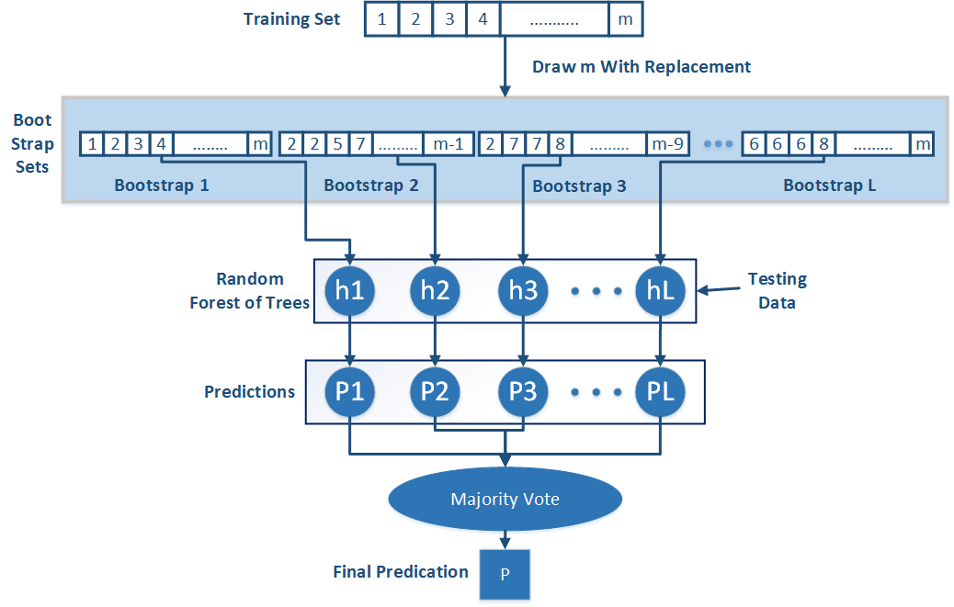
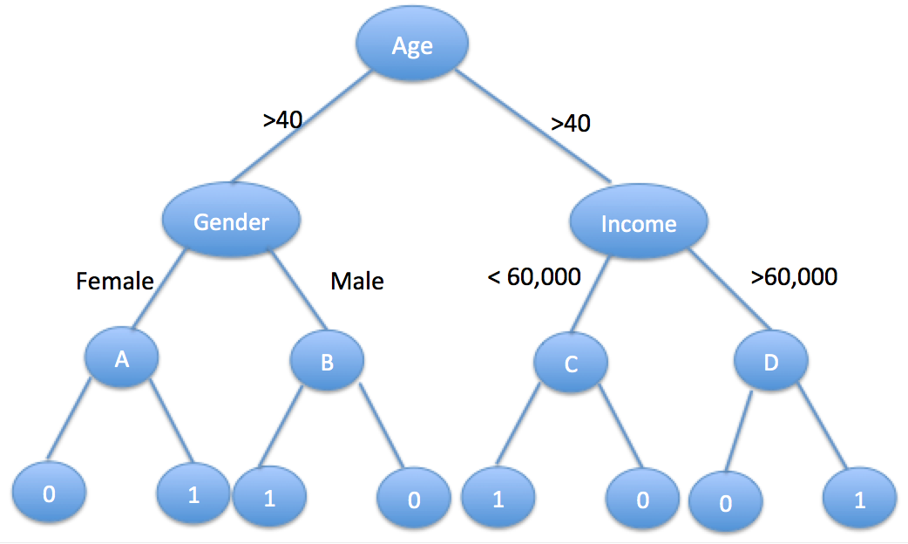
Random Forest
Train dataset
Predict based on each tree
Majority vote
Build random tree
Draw Bootstrap Samples
A Random Tree
Notes:
A machine learning ensemble algorithm: a method of combining multiple predictors
Applicable to both regression and classification problems (based on decision tree models, all the trees become the forest)
No formal distributional assumptions (non-parametric)
Automatic variable selection; Handles missing values, Variable importance;
Robust: if we change the data a little, the individual trees may change but the forest is relatively stable because it is a combination of many trees.
Reduce variance; Improve stability and accuracy of models
Grow a binary tree
At each node, split data into two ‘daughter’ nodes.
Splits are chosen using a splitting criterion(Gini)
Bottom nodes are ‘terminal’ nodes

Slide 17
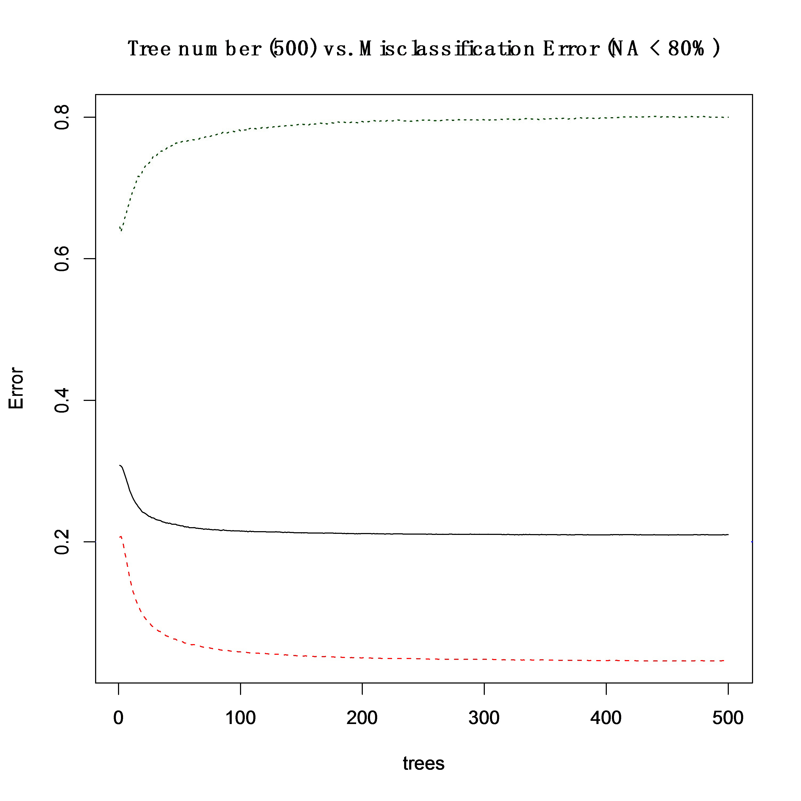
Random Forest
Tree number(500) vs Misclassification Error
Confusion matrix |  | Prediction
Truth |  | 0 | 1
 | 0 | 36157 | 1181
 | 1 | 8850 | 2223
Target =1
Overall
Target =0
 | Accuracy
Overall | 79.3%
Target = 1 | 20.1%
Target = 0 | 96.8%

Slide 18

XGBoost
Additive tree model: add new trees that complement the already-built ones
Response is the optimal linear combination of all decision trees
Popular in Kaggle competitions for efficiency and accuracy
Additive tree model
……..
Greedy Algorithm
Error
Number of Tree
Notes:
Xgb is another tree model，actually it is a very popular tool in data mining due to its extremely fast speed and high performance.
As a tree model, xgb can do parallel computation, 10 times faster than Random forest.
It is an additive tree model based on greedy method. In each step, a new tree is added to compliment the already built Trees. This normally gives you better accuracy with more trees. The final response is the weighted sum of all predictions from each individual trees or we can say it is the optimal linear combination of all decision trees.
For each decision tree, features flowing into the tree will finally reach the leaf by the binary critraten , we do not need to do careful features normalization. -----suitable for cate data
These two advantage makes it an ideal model in our case:
fast spead , handle large scale dataset--------
Handle cate ----anonymous features with cate and num var combined.

Slide 19
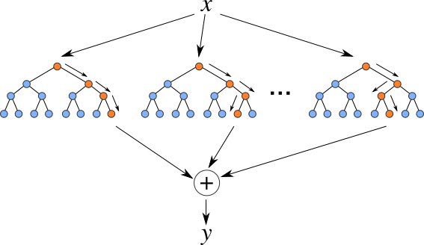
XGBoost
Additive tree model: add new trees that complement the already-built ones
Response is the optimal linear combination of all decision trees
Popular in Kaggle competitions for efficiency and accuracy
Notes:
Xgb is another tree model，actually it is a very popular tool in data mining due to its extremely fast speed and high performance.
As a tree model, xgb can do parallel computation, 10 times faster than Random forest.
It is an additive tree model based on greedy method. In each step, a new tree is added to compliment the already built Trees. This normally gives you better accuracy with more trees. The final response is the weighted sum of all predictions from each individual trees or we can say it is the optimal linear combination of all decision trees.
For each decision tree, features flowing into the tree will finally reach the leaf by the binary critraten , we do not need to do careful features normalization. -----suitable for cate data
These two advantage makes it an ideal model in our case:
fast spead , handle large scale dataset--------
Handle cate ----anonymous features with cate and num var combined.

Slide 20
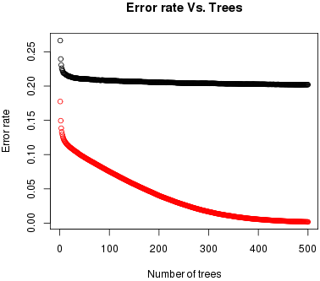
XGBoost
Confusion matrix |  | Prediction
Truth |  | 0 | 1
 | 0 | 35744 | 1467
 | 1 | 8201 | 2999
Test error
Train error
 | Accuracy
Overall | 80.0%
Target = 1 | 26.8%
Target = 0 | 96.1%
Notes:
Xgb result
Left:
error rate with the increase of number of tree
the error decrease with more trees added,
Right: auc increase with more tree added
For xgboost, parameter tuning can give us significant improvement on accuracy the best result compare other method.

Slide 21
Methods Comparison

Slide 22


Winner or Combination ?
Notes:
As we have tried so many methods, some are good, some are not so good. Is there a way that we can combine our good methods together to get a better performance instead of choosing a winner model among them?
Next We will introduce stacking method. it is a ensemble technique for combining multiple weak learners in an attempt to produce a strong one.

Slide 23
Stacking
Main Idea: Learn and combine multiple classifiers
Train
Test
Base learner C1
Meta
features
Final
prediction
Labeled
data
Base learner C2
……
Base learner Cn
Notes:
Idea of stacking is simple: we do want to learn a single classifier but learn a number of classifiers
Combine the predictions of these multiple classifiers.
It usually has two steps.
First, a number of base learners are produced independently like C1 to Cn, and obtain individual predictions from each base learners, these predictions are also called meta feature which implis they are are going to be treat as additional features to our original data set.
We combine them with our original data set we can form a new data set. Based on which, we train a higher level learner it’s also called meta learner and make the final prediction from the meta learner.
The employment of different base learners or combination methods lead to different stacking model

Slide 24
Generating Base and Meta Learners
Base model—efficiency, accuracy and diversity
Sampling training examples
Sampling features
Using different learning models
Meta learner
Majority voting
Weighted averaging
Kmeans
Higher level classifier — Supervised(XGBoost)
Unsupervised
Notes:
It has been formally shown and emphasized that, to get a better prediction on stacking, the base learners should be as more accurate as possible, and as more diverse as possible. As diversity can reduce the correlation between the meta features.
Generally, we could use Sampling features or training data(just like what does in RF) or we can use different learning models, injecting randomness into learning algorithms, or we can apply them simultaneously
As for the meta learner, the most popular combination methods are majority voting for classification , weighted averaging, kmeans, or a higher level classifier. The first 3 are un the last one is supervised. Stacking method often choose the supervised classifier as meta learner.

Slide 25
Stacking model
XGBoost
XGBoost
Random Forest
Logistic Regression
Predictions
Total data
Meta Features
Total data
Sparse
Condense
Low level
PCA
…
Final
prediction
Base learners
Combined data
Meta learner
❶
❷
❸
Notes:
Here is our stacking model. In order to introduce variability to base models, we use the total data and different subsets of total data as our training data, like the subset of only the low level features, sparse features or condense features. we applied different learners on these data set and select the most accurate predictions as the meta feature. Like we showed before, xgb,lg and rf have better performance, they are our base learners in part one. Then we combine meta features with our total data to form a new data set in part 2. In the third part, we trained another xgboost as a higher learner based on the new data set to make our final prediction .

Slide 26
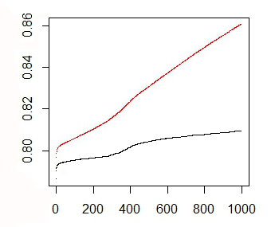
Stacking Results
Base Model | Accuracy | Accuracy (target=1)
XGB + total data | 80.0% | 28.5%
XGB + condense data | 79.5% | 27.9%
XGB + Low level data | 79.5% | 27.7%
Logistic regression+ sparse data | 78.2% | 26.8 %
Logistic regression+ condense data | 79.1% | 28.1%
Random forest + PCA | 77.6% | 20.9%
Accuracy of XGB
Meta Model | Accuracy | Accuracy (target=1)
XGB | 81.11% | 29.21%
Averaging | 79.44% | 27.31%
Kmeans | 77.45% | 23.91%
Notes:
Let’s see the results from our base and meta model. For base model, we used different subset of data, different learning models. We produce 6 base models here. For meta model, we mainly used xgb. After stacking, our result improve about 1% percent compared with the best result of base models. Actually, 1 percent really means a big promotion in the kaggle competation. Also we tried unsupervised averaging and kmeans on the meta features but they didn’t give us higher accuracy than xgboost.

Slide 27
Stacking Results
Base Model | Accuracy | Accuracy (target=1)
XGB + total data | 80.0% | 28.5%
XGB + condense data | 79.5% | 27.9%
XGB + Low level data | 79.5% | 27.7%
Logistic regression+ sparse data | 78.2% | 26.8 %
Logistic regression+ condense data | 79.1% | 28.1%
Random forest + PCA | 77.6% | 20.9%
Accuracy of XGB
Meta Model | Accuracy | Accuracy (target=1)
XGB | 81.11% | 29.21%
Averaging | 79.44% | 27.31%
Kmeans | 77.45% | 23.91%
Notes:
Let’s see the results from our base and meta model. For base model, we used different subset of data, different learning models. For meta model, we mainly used xgb. After stacking, our result improve about 1.5% percent compared with the best result of base models. Actually, 1 percent really means a big promotion in the kaggle competation. Also we tried unsupervised averaging and kmeans on the meta features but they didn’t give us higher accuracy than xgboost.

Slide 28
Summary and Conclusion
Data mining project in the real world
Huge and noisy data
Data preprocessing
Feature encoding
Different missing value process:
New level, Median / Mean, or Random assignment
Classification techniques
Classifiers based on distance are not suitable
Classifiers handling mixed type of variables are preferred
Categorical variables are dominant
Stacking makes further promotion
Biggest improvement came from model selection, parameter tuning, stacking
Result comparison： Winner result: 80.4%
Our result: 79.5%
Notes:
This is a specific data mining project in the real world. What we face is not the well designed and clean data in our textbook, but huge and dirty data with a lot of missing and mixed type of features.
It cost many efforts to determine inaccurate, incomplete data and improve the data quality.
Actually, some feature encoding like adding date difference give us an impressive promotion. And in our case, Fill the missing value with median value has better performance than fill missing with mean value or randomly replace missing according to value distribution.
Also we tried a lot of classification methods, no matter they are numerical or cate classifier. The final result shows the methods which based on distance like svm, knn are not suitable here. but tree model or lr which can natural handle data of mixed type are preferred. This may imply that cate variables are dominant in our data set.
To further improve our result ,we applied stacking method to combine the base learner which give us additional 1% promotion on accuracy.
Overall , the most significant improvement came from model selecting, parameter tuning, Stacking.

Slide 29
Acknowledgements
We would like to express our deep gratitude to the following people / organization:
Profs. Bremer and Simic for their proposal that made this project possible
Woodward Foundation for funding
Profs. Simic and CAMCOS for all the support
Prof. Chen for his guidance, valuable comments and suggestions
Notes:
This project offers us a gold opportunity to learn and apply data classfication technique. First, We would like to express special thanks of gratitude to our adviser Prof. chen who guilded us to do this wonderful project, teach us so many new things and give us valuable suggestions
Secondly we would like to thank Woodward for funding and Prof. Bremer and Simic for their proposal of this project.
The last but not the least, Dr. Simic and CAMCOS offered us a lot of support in the project, we would also like to express our thanks to them.

Slide 30
QUESTIONS?
Notes:
That is all our presentation, thank you for your attentation?
Any question?

